Slide 1

WikiTrend Analytics Using Cloud
Team Members: Rajendra Kumar, Mukund Komati, Ajay Reddy Gajulapally

Slide 2
Roles of Team Members
Rajendra: Role: Project Lead and Data Architect Responsibilities: Setting up the ETL pipeline, managing data extraction, and cloud infrastructure.
Mukund: Role: Data Engineer Responsibilities: Data transformation, cleaning, and analysis for generating insights.
Ajay: Role: BI Engineer Responsibilities: Creating dashboards and visualizations for user interaction and presenting insights.

Slide 3
Project Overview
Title: WikiTrend Analytics using Cloud
Objective: To build an ETL pipeline using Wikimedia Analytics data, process the data for insights, and create visualizations that showcase user trends like pageviews, edits and media usage.
Tools and Technologies: Jetstream, Apache Hadoop, PySpark, MapReduce, Hive, Python, Visualization tools

Slide 4
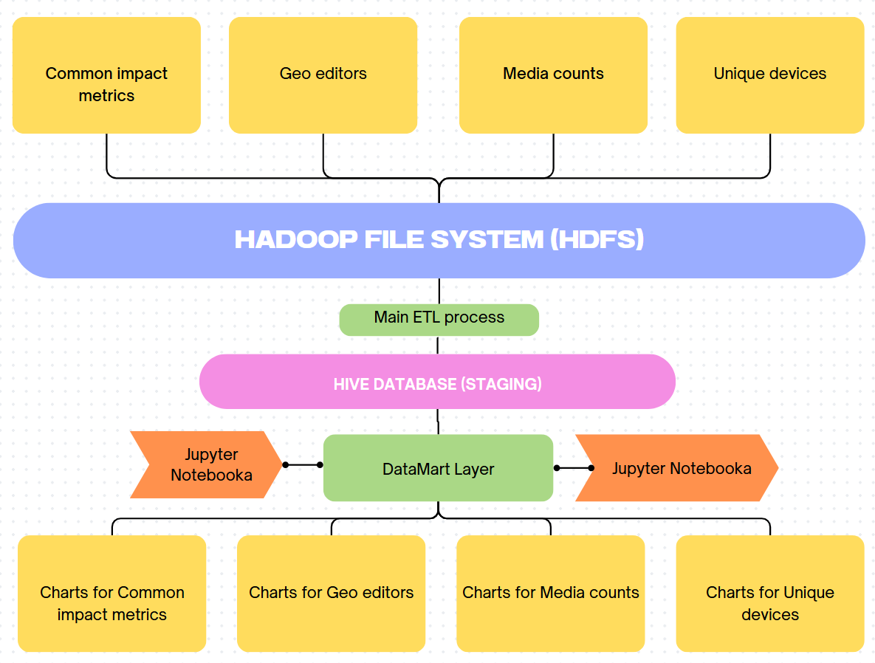
Technical Approach

Slide 5
Project Status
Task | Status | Remarks
Infrastructure Setup | Completed | Installed and configured Hadoop, Hive, Tez, Hue, Postgres Meta store.
Initial dataset selection | Completed | Selected tables: Commons Impact Metrics, Media Counts, Geo Editors, Unique Devices.
Data Extraction | Completed | Successfully retrieved datasets using Wikimedia APIs using python scripts.
Data Transformation | Completed | Data cleaning and normalization were performed. Anomalies were removed. Null checks, feature engineering.
Load Processed Data | Completed | All Selected 4 tables were loaded into hive database, named it staging. It is the raw datastore.
Data Analysis and Insight Generation | In Progress | Performed Analysis on Media counts, Geo Editors, Unique Devices, Commons Impact Metrics
Visualization | To do | -

Slide 6
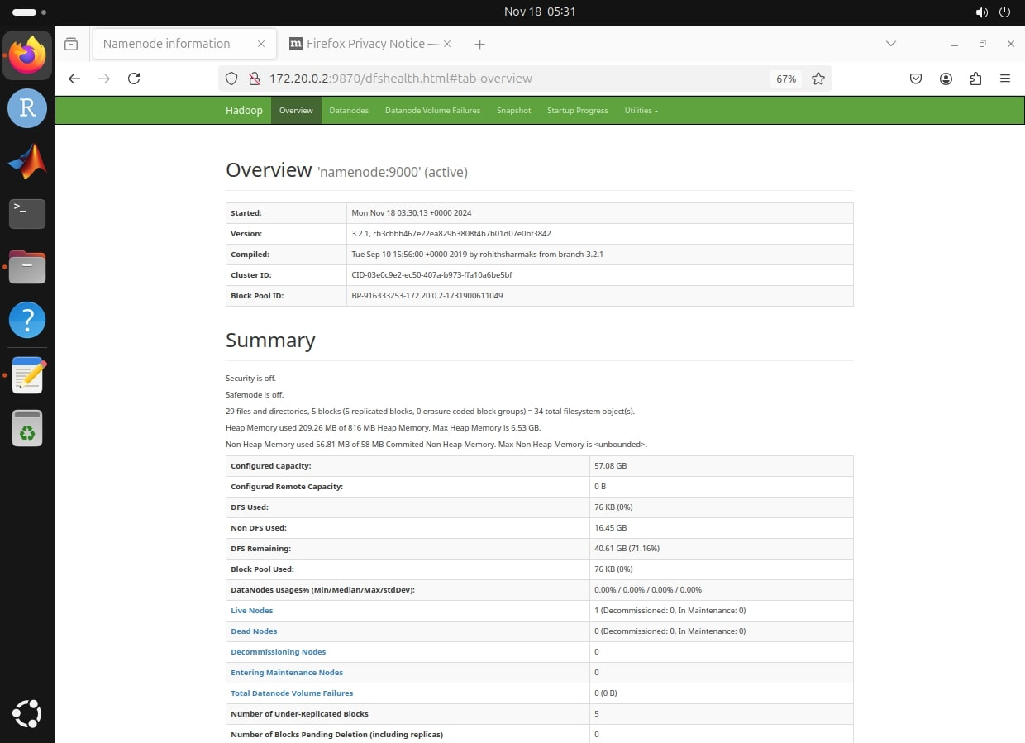
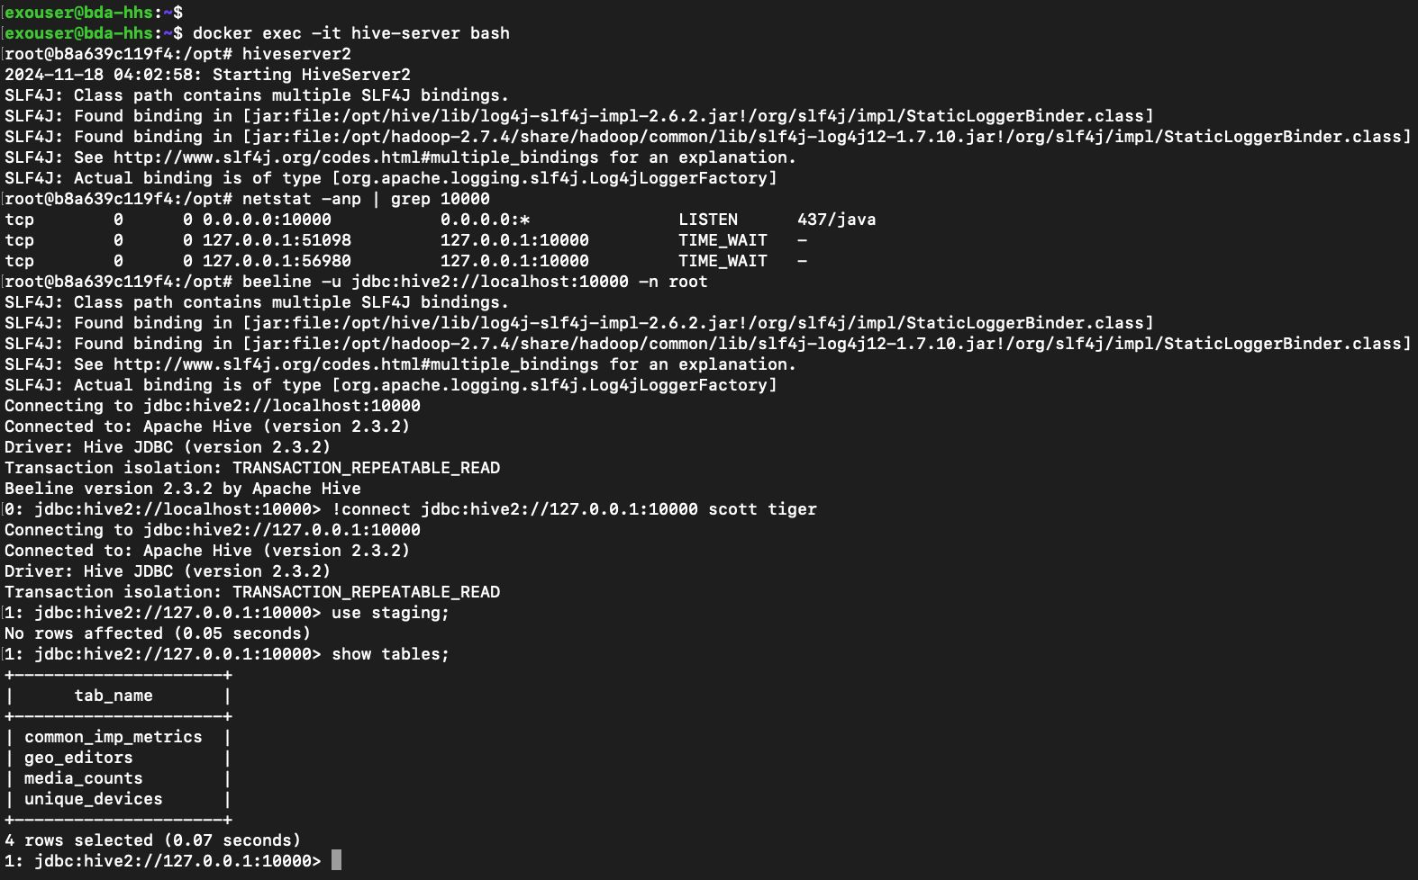
Preliminary Results
Hadoop and HDFS Setup
Hive Setup

Slide 7
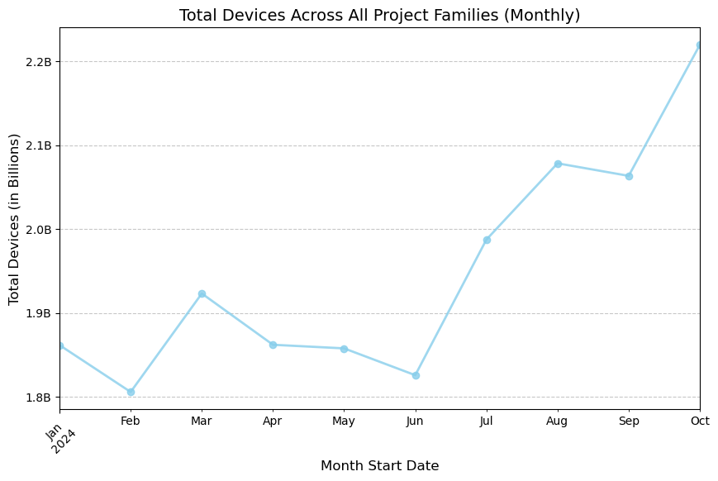
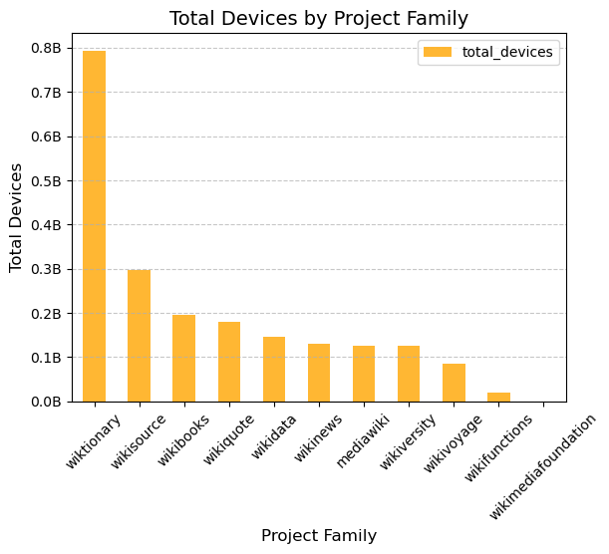
Preliminary Results
Project Family Monthly
Note : Source Wikipedia had 17.5B unique devices in 2024

Slide 8
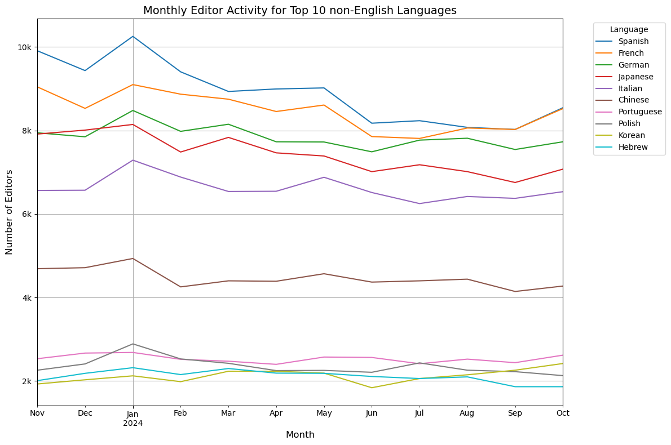
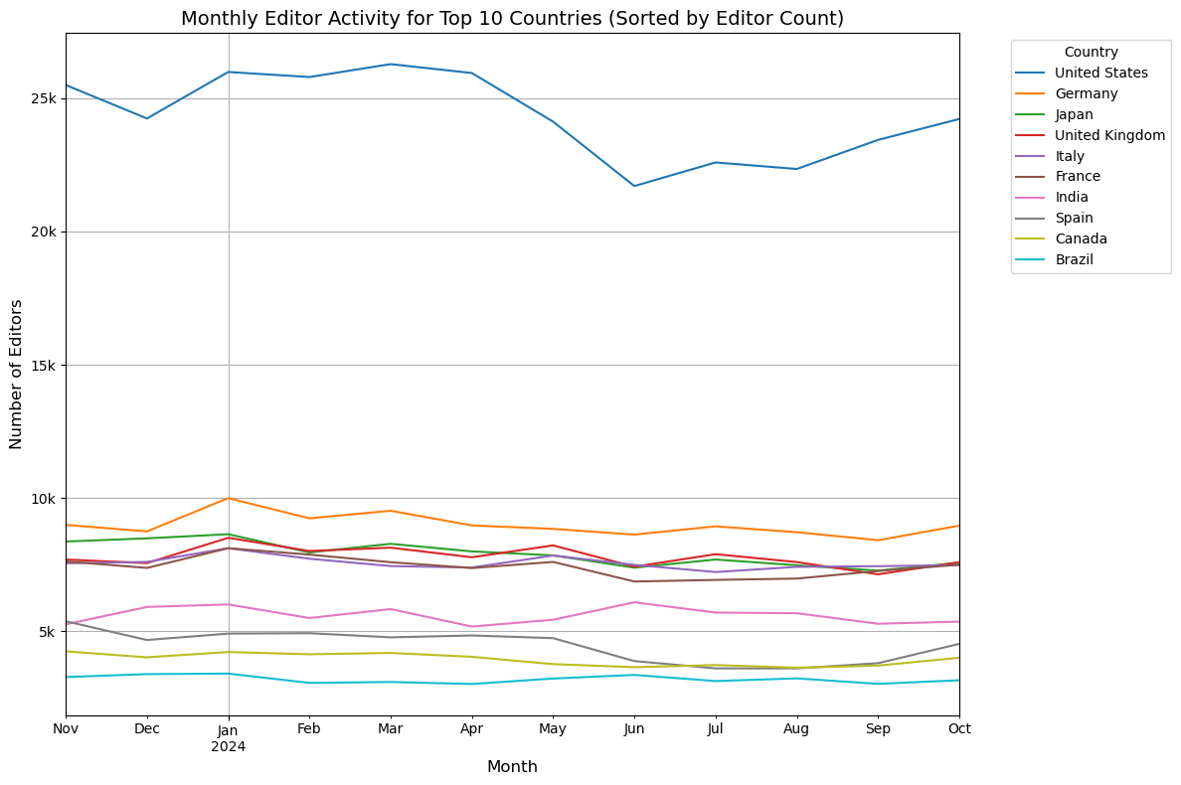
Preliminary Results
Geo Edits Per Month Per Country

Slide 9
Road Map
Week 5 (Nov 18 – Nov 22) : Build Analysis for Media Counts, and Common Impact Metrics.
Week 6 (Nov 23 – Nov 30): Develop visualizations (Unique Devices, Media Counts, Common Impact Metrics, Geo Edits) and connect Hive to the visualization tools. Prepare the final project report.
Week 7 (Dec 1 – Dec 5): Test the full pipeline, ensure seamless data flow from extraction to Hive and dashboards, finalize dashboard design, and prepare the presentation.

Slide 10
Deliverables
ETL Pipeline: Build a scalable pipeline to process Wikimedia datasets using Hadoop, PySpark, and Hive.
Data Insights: Extract metrics like Unique Devices, assessing edits by country, Total Transfers of the images per category and page view counts.
Interactive Dashboards: Create interactive visualizations using available tools.
Documentation: Provide a detailed project report and user guide.
Project Presentation: Showcase the dashboards, and key findings from the datasets.

Slide 11

Thank you

